Slide 1
Cleaning of Null Values
Whats Types of Null Values ?

Slide 2
There 3 Types of Null Values
There are ordinary Null values .
Structure Null values .
Values and outliers .
Structure null values like → ? , . , - , $ , % , units and other symbols .
outlier value : its vertical far value , or value that be so far about other values like this :
5,10,15,100,35,500,100000 , here we found that 100000 be outlier value .

Slide 3

How Cleaning Null Values ?
there are many ways to clean the data :
like fill the null values in Speific feature with zero or one or
. using method simple-Imputer and select the strategy for the data.
. Strategy different by different type of feature :
. if Numerical data: then i use mean or mode strategy.
. if Categorical data: then use mode strategy.
we also can use dropna() to drop the null values.

Slide 4

How detect outliers & Get Grid from it ?
here are many methods to detect the outlier such Z-Score method & Quantile method (upper limit ,lower limit ,IQR).
Decide on a strategy to handle outliers, such as removing them, capping them, or imputing them with a more reasonable value.
Example:Human heart rate curve

Slide 5
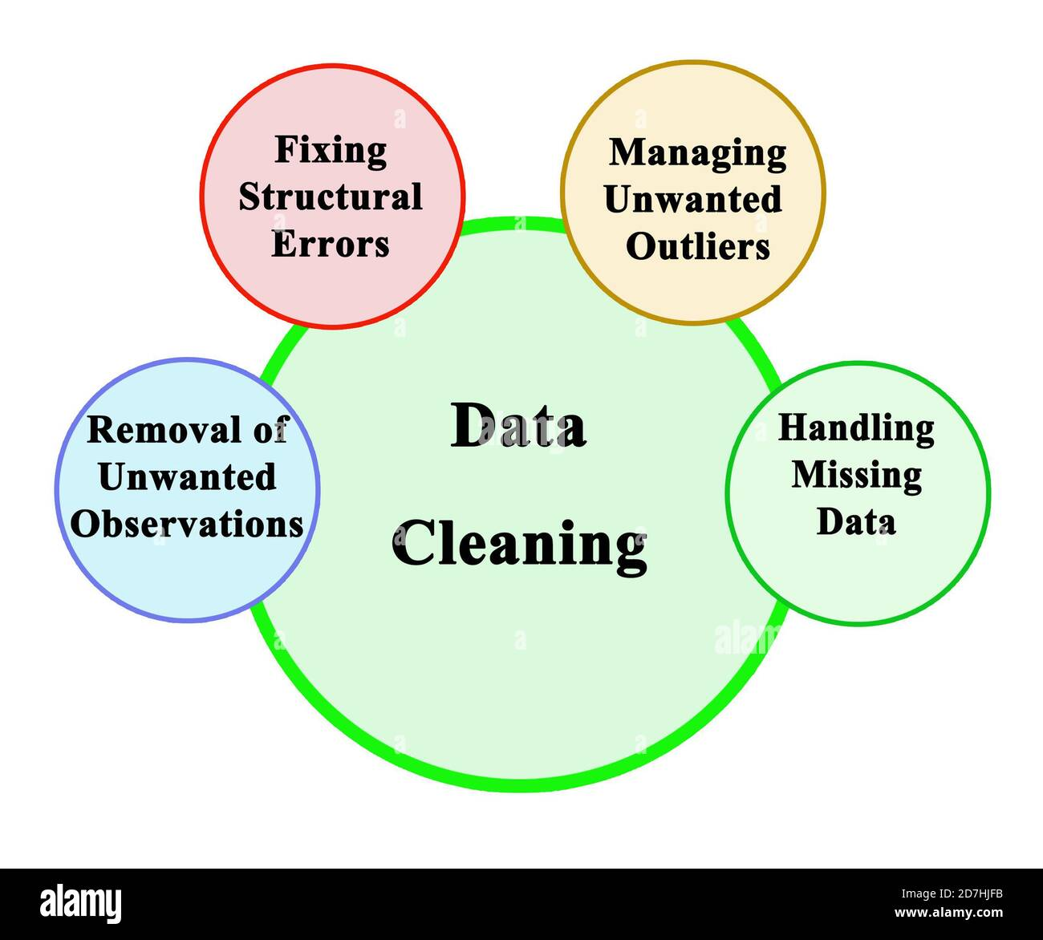
Cleaning Types of Null Values

